Slide 1

Software Project & Risk Mitigation & Monitoring Plans
Project MoonEyes, a Metro Detective Agency Database
Team Members
Kendall Gesek
Erika Valle-Baird
Kylie Callison
Pamela Shahu

Slide 2
1.0 Scope

Slide 3
2.0 Project Estimates
Historical Data
For this estimation we will use the 25th percentile cost estimation because we are all inexperienced.
$((80,130/12)(1+1+1+1) /4) ≈ $6,667
Burdened labor rate can be up to 1.5-2.5x as much as a normal labor rate
To obtain accurate results we used a burdened labor rate of $8000/month
Michigan
Mean wage
Annual: $101,800
Hourly: $48.94
Percentile wages
Data: U.S. Bureau of Labor Statistics May 2022
10th | 25th | 50th | 75th | 90th
$61,090 | $80,130 | $101,070 | $126,420 | $140,120

Slide 4
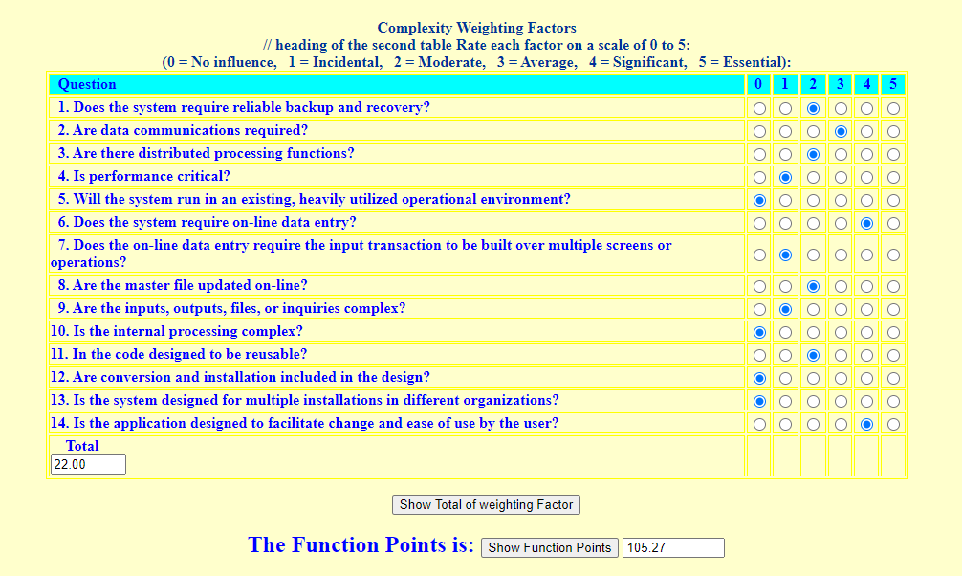
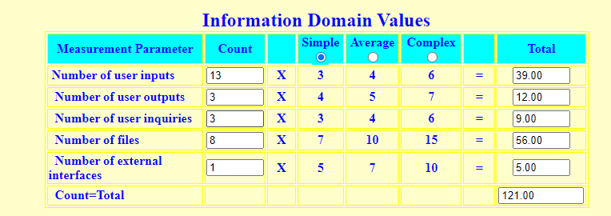
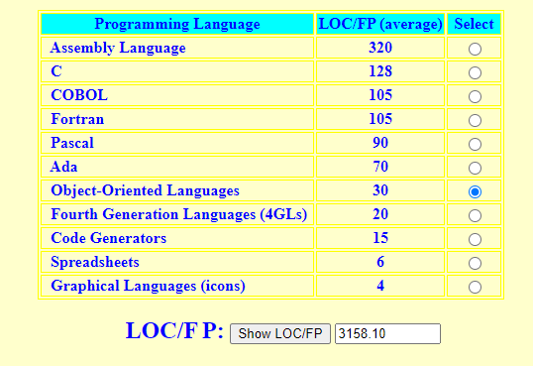
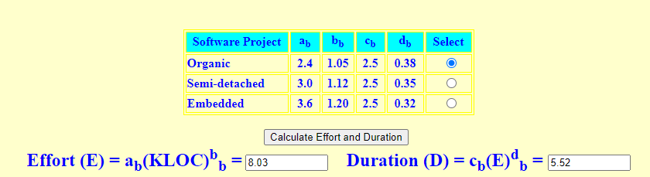
2.0 Project Estimates
Function Point COCOMO

Slide 5
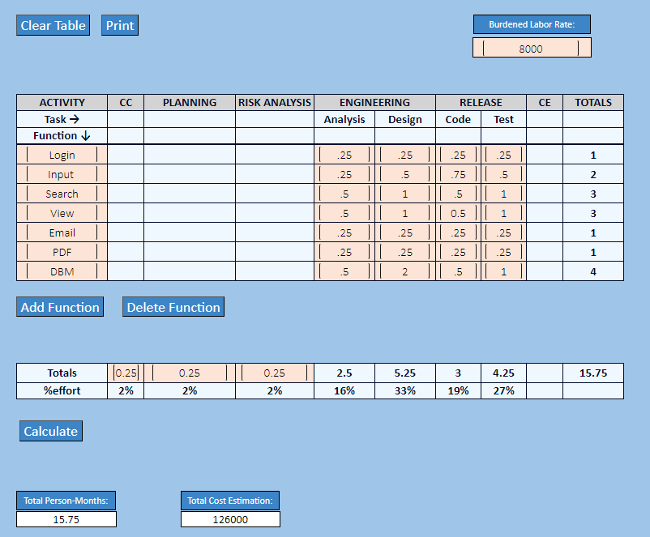
2.0 Project Estimates
Process-Based Estimation

Slide 6
2.0 Project Estimates
Reconciled Estimate
Average of both estimates
LOC: 3158
Number of Developers: 4
Person Months: 15.8 months
Person Months/Developer or Duration of Development: 3.96
Project Cost: $127,741

Slide 7
2.0 Project Estimates
Project Resources
People
Four Developers
Hardware
Development
Need PC with internet connection and specifications to withstand the writing, debugging, testing of Moon Eyes within a version control system.
User Client-side
Need PC with internet connection and access to a browser
Software
Development
Version Control system such as GitHub
User license or access to OOL-supported IDE such as Virtual Studio Code
Other resources
Development & Deployment
The development team will also need access to various tools in order to develop and deploy the software. Because we will be creating a database users will need access to MySQL
Additionally, we will be deploying on an Amazon EC2 web server so we will need an AWS account in order to test

Slide 8

3.0 Description of Risk m
Business Impact Risks
Production of a product that is not viable
Customer Risks
Customers fail to participate in timely communication
Development Risks
Coding and system performance
Employee Risks
Unfamiliarity with the technology
Process Risks
Quality assurance metrics are not developed correctly
Product Size
When erroneous assumptions in product size
Technology Risk
The use of antiquated technology and software
Financial Risks
Impact our project if there are budget overruns or incorrect cost estimations

Slide 9
3.2 Risk Table
Risk ID | Risks | Probability | Impact
BI | Business Impact Risk | Low | High
C | Customer Risks | High | High
D | Development Risks | Medium | Low
E | Employee Risk | Low | High
P | Process Risk | Medium | High
PS | Product Size | High | High
T | Technology Risk | Medium | Medium
F | Financial | Medium | High

Slide 10
3.3 Overview of Risk Mitigation, Monitoring, Management
Risk monitoring and management for risk m
Risk ID | Risk | Monitoring | Management
BI | Business Impact Risk | Monitor the rates and analyze the changes that may affect our budget. | The required hardware is purchased from the best available market
C | Customer Risk | Take feedback from the users and conduct usability testing. | List all the user requirements in the SRS document according to the feedback of the users
D | Development Risks | Conduct code review to make sure that all the developers are working with the same standard and are following the instructions. | One or two days training for developers to get familiar with the coding standard.
E | Employees Risk | Motivate the employees to use technology and get their feedback | Conduct training to ensure that all the employees have enough skill set to use the modern automated system.

Slide 11
Risk monitoring and management for risk m cont.
Risk ID | Risk | Monitoring | Management
P | Process Risk | Install a monitoring system to track the performance of the system and make a register to check the graphs if it’s going up or down. | Integrate and test the backup system with the actual system to avoid any downtime.
PS | Product size | Monitor the performance metrics to keep check on the performance and follow the response time | Conduct the load testing to make sure that the system has the capacity to handle the big volume of users and data.
T | Technology Risk | Check the compatibility of the system with the browsers and other required third-party systems. | Conduct testing for the integration with third- party software and compatibility with different browsers.
F | Financial Risk | Monitor the cloud system and storage that our system is using to store the date of users and cases. | Conduct reviews on cloud resources allocations and implement optimization tools and techniques.

Slide 12
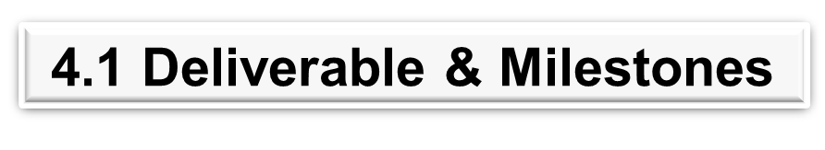
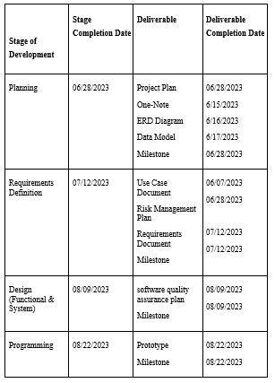
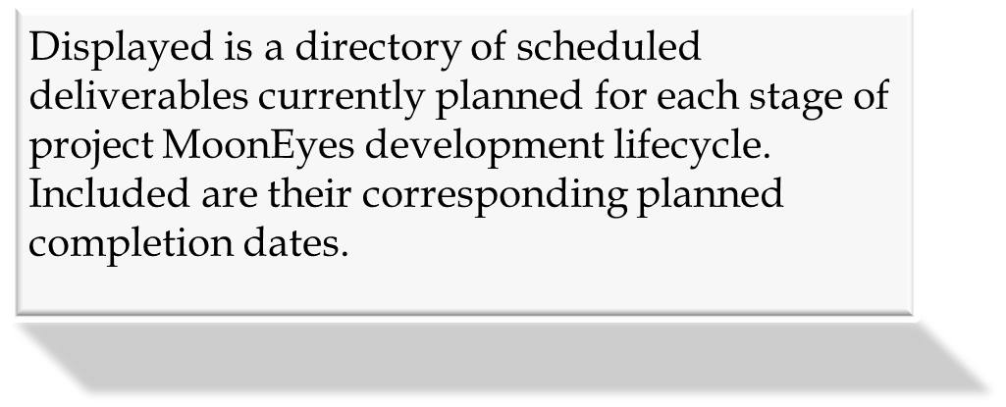

Slide 13
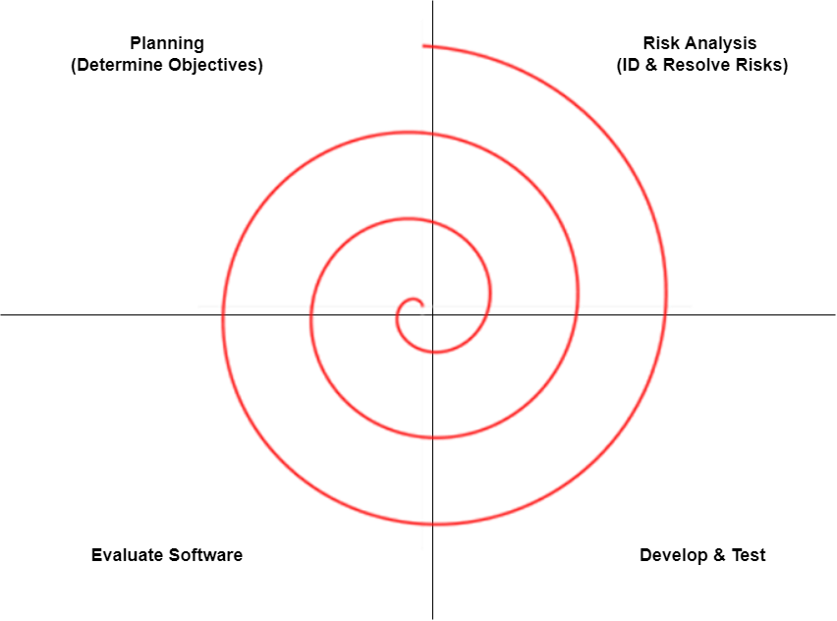


Metro Detective Agency software will employ a Spiral Model during design and implementation. This was determined due to client uncertainty, allowing us to develop acceptable solutions as well as allow for stronger emphasis of risk assessment. Weekly check-ins have also been employed to improve communication with our clients. To ensure customer satisfaction, customer requested documentation, unrelated to course work, have been completed for feedback. These additions will help elevate document deadline delays along with allowing us to develop elements for the product as soon as it becomes available. Due to the high uncertainty related via our clients, this model also allows us to accommodate any desired changes.

Slide 14
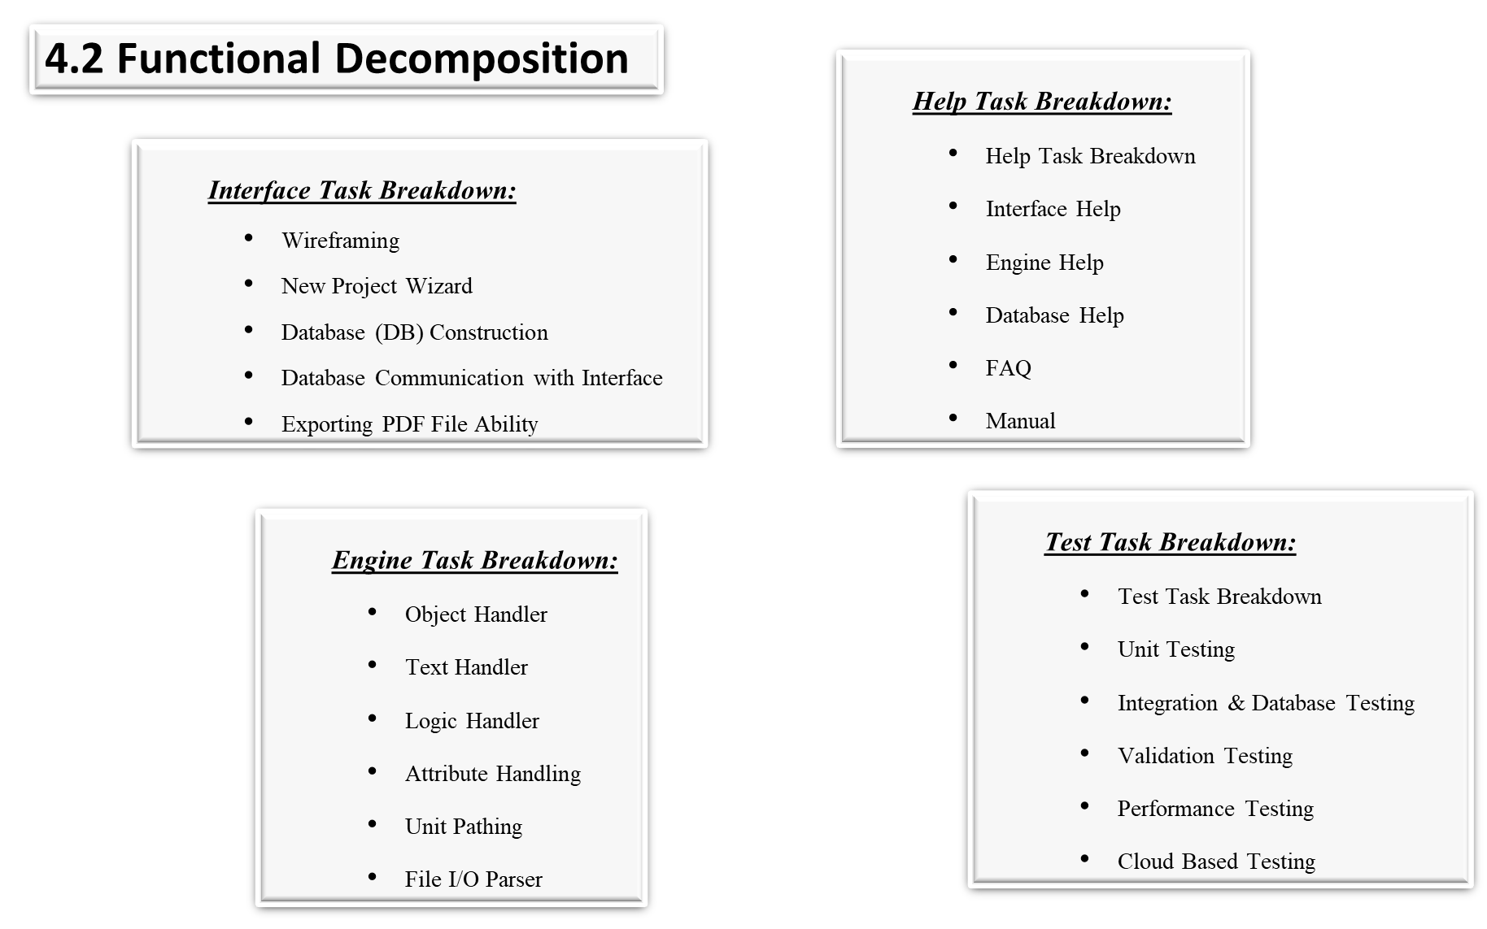

Slide 15
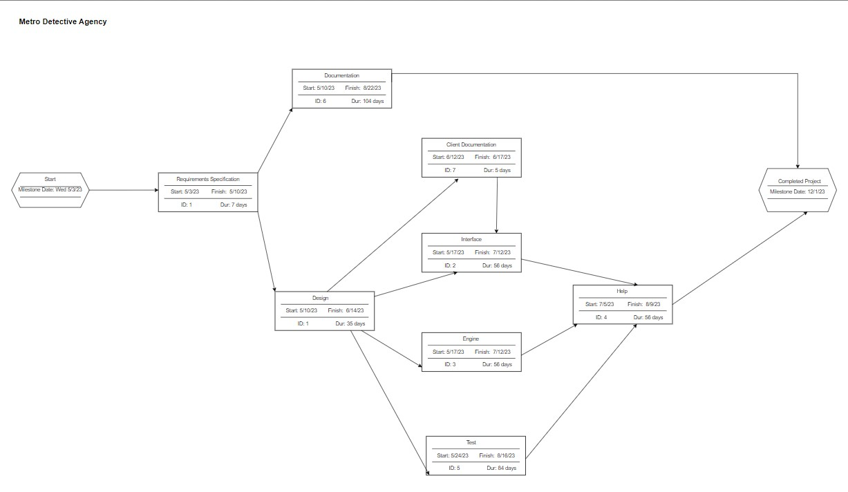
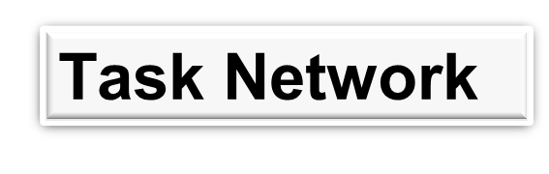


Slide 16

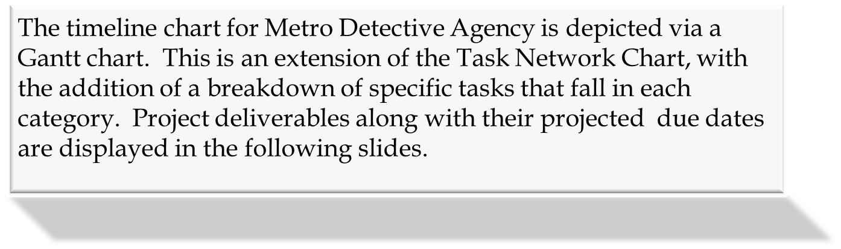

Slide 17
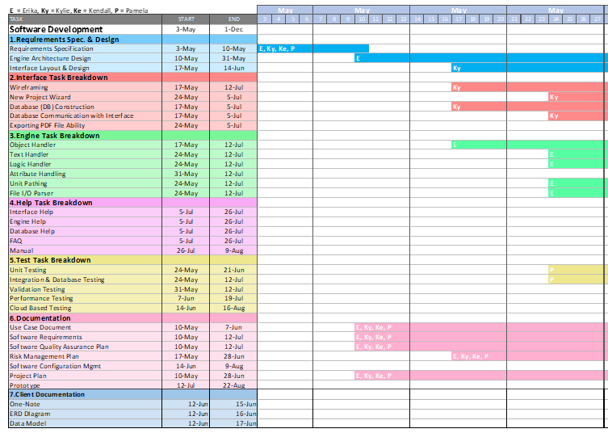

Slide 18
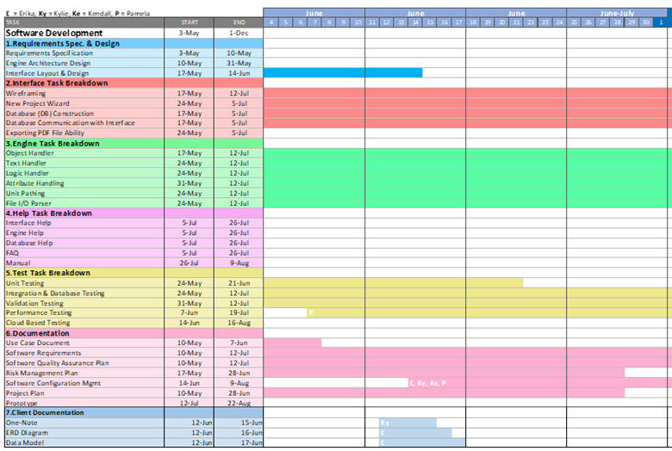

Slide 19
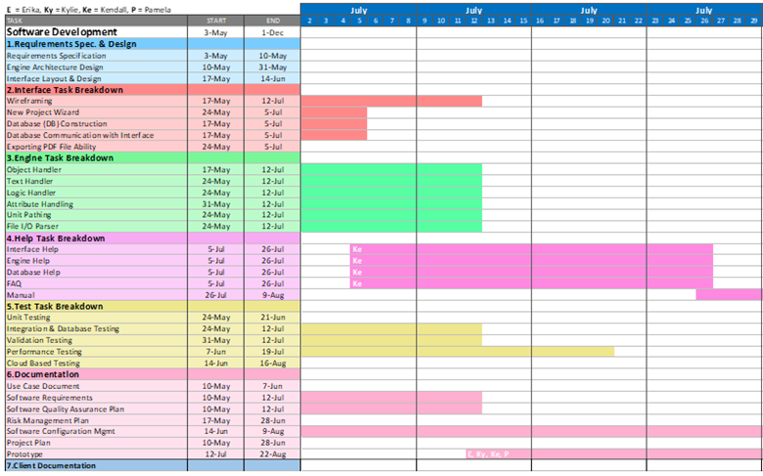

Slide 20
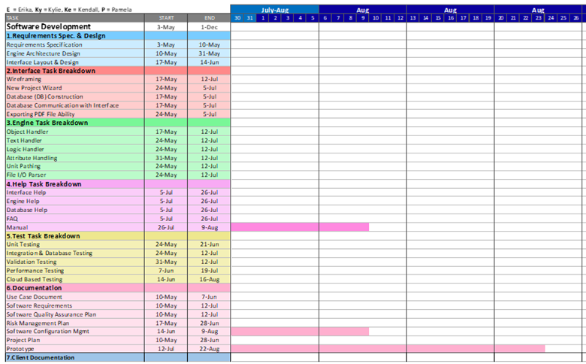

Slide 21
5.0 Staff Organization

Slide 22
5.1 Team Structure

Slide 23
5.2 Management Reporting & Communication

Slide 24
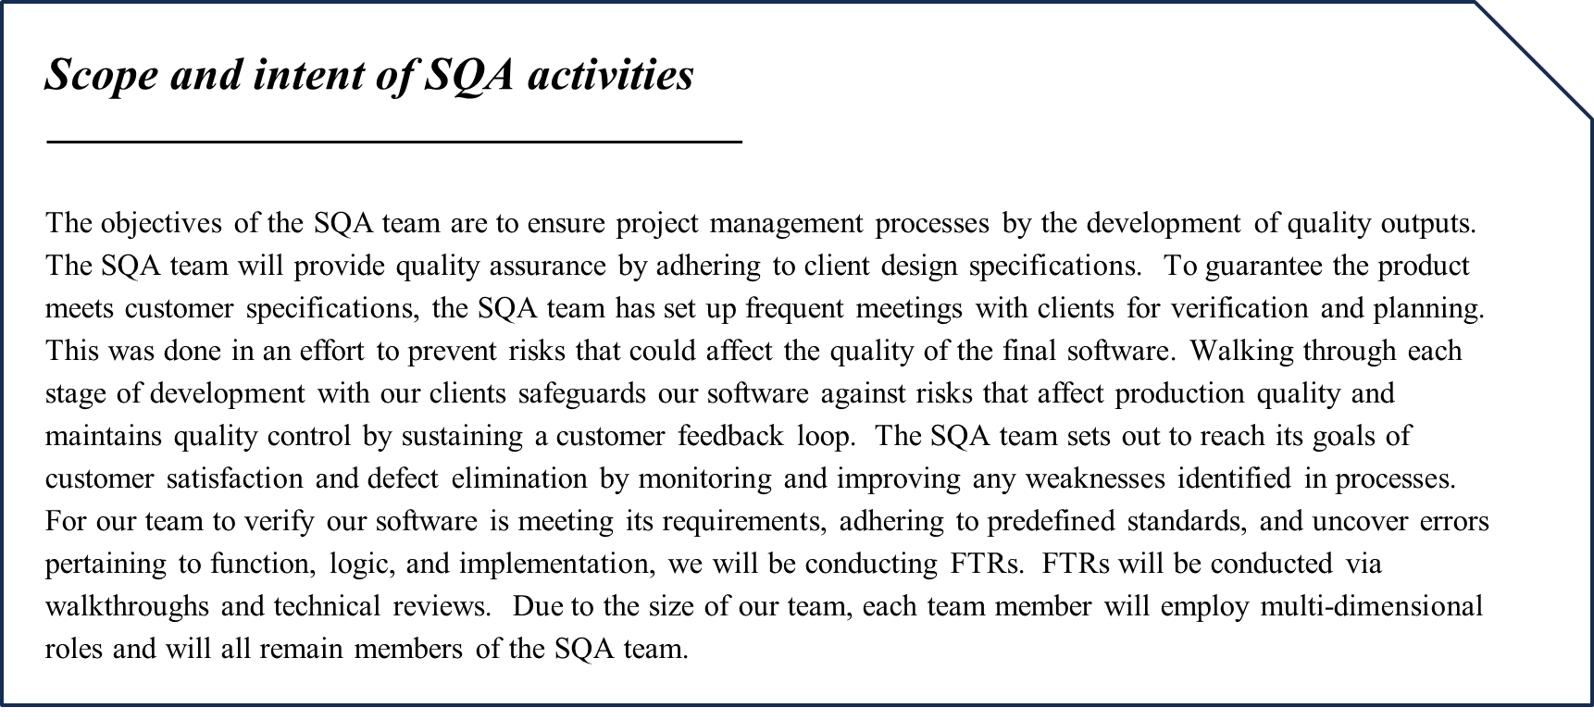

Slide 25
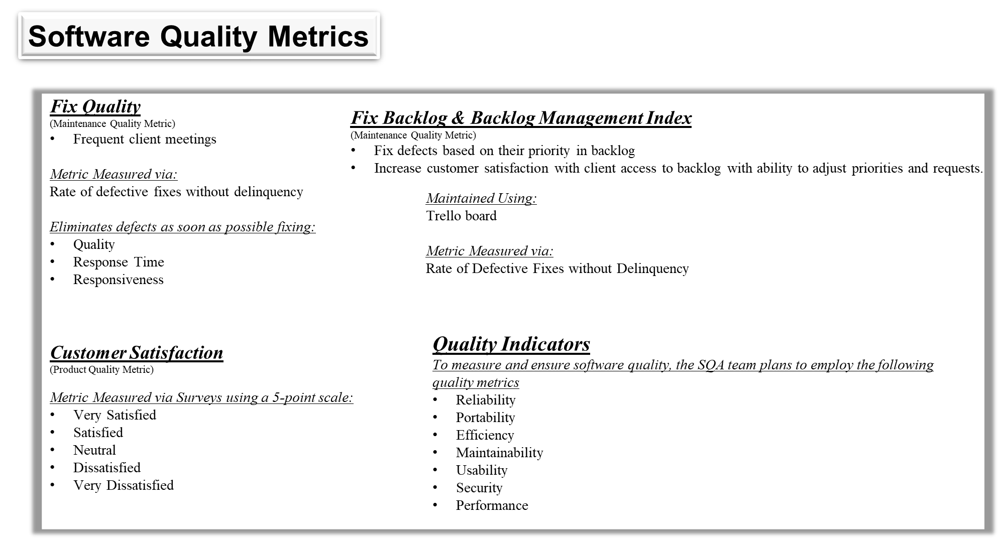

Slide 26
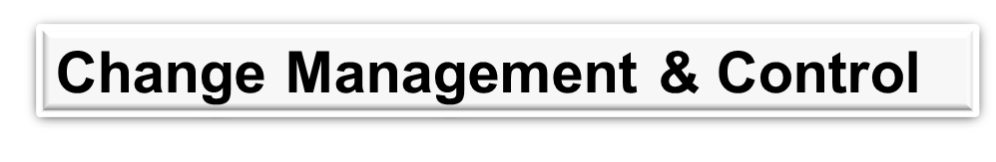
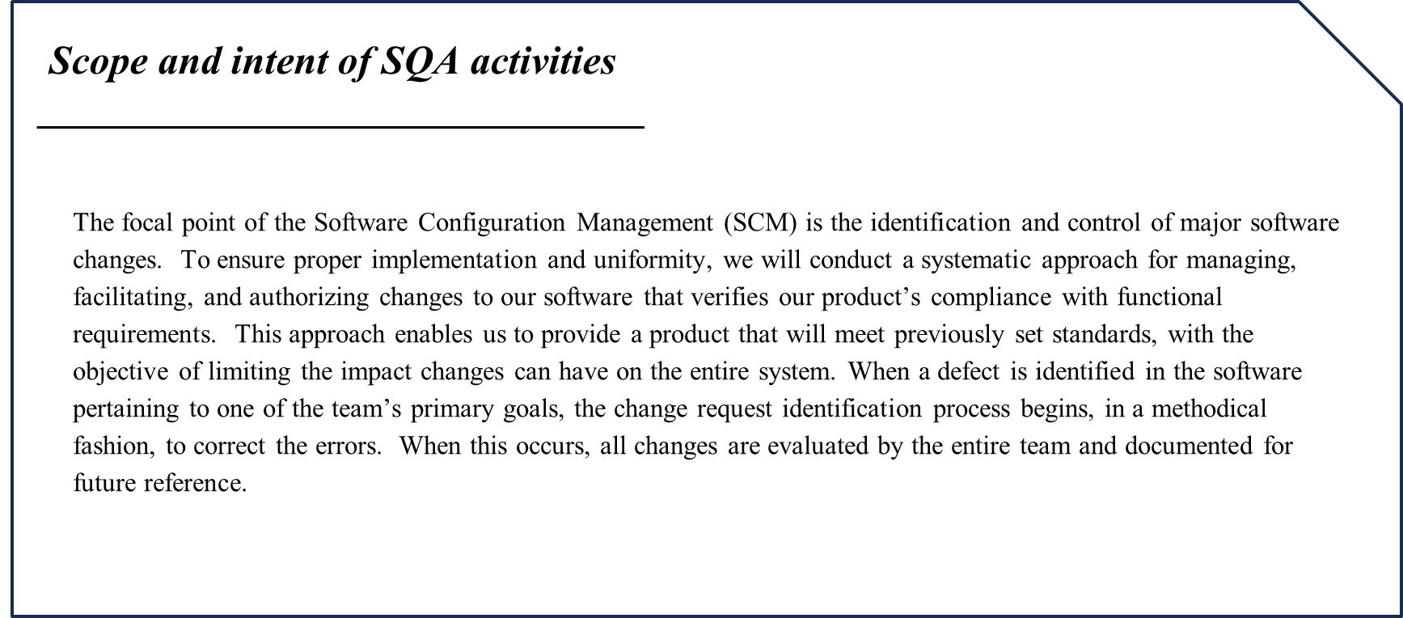

Slide 27
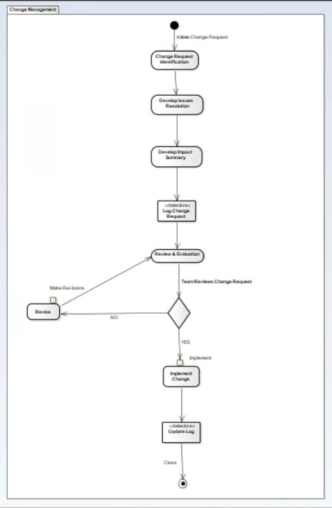
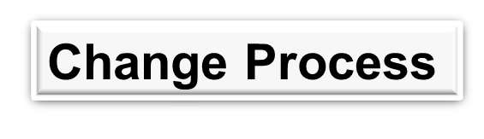
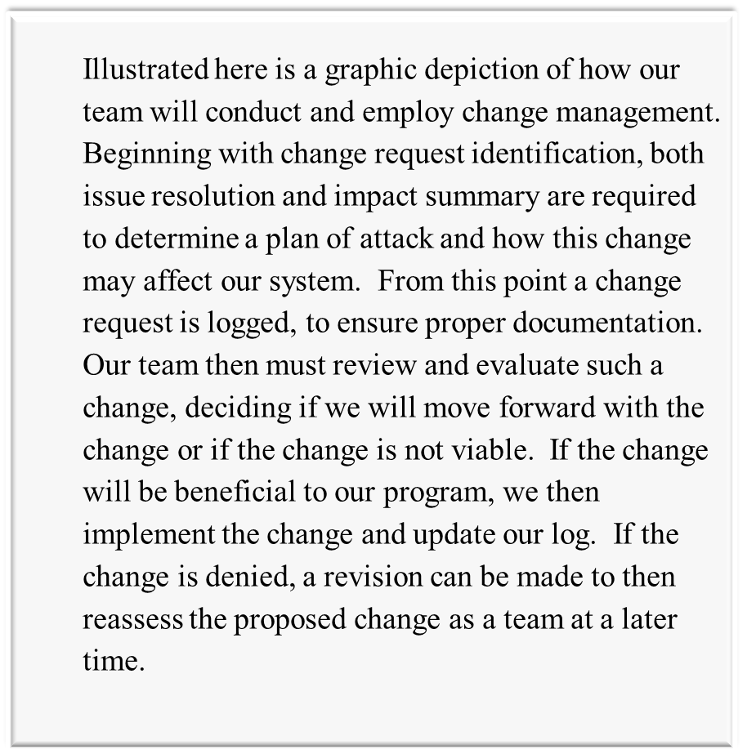

Slide 28
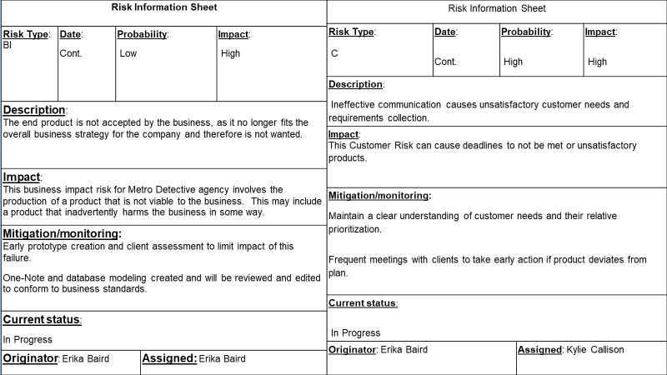

Slide 35
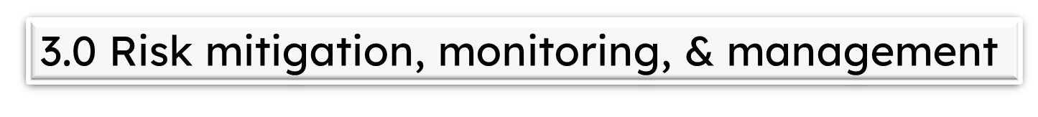
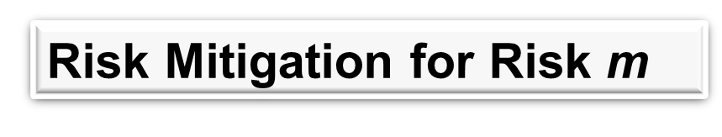
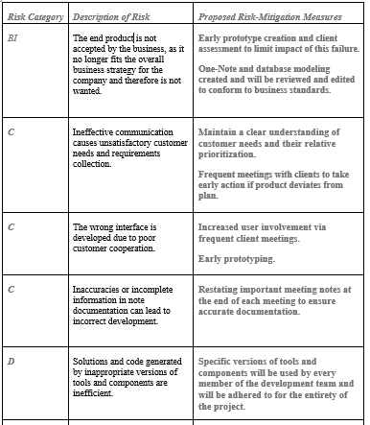
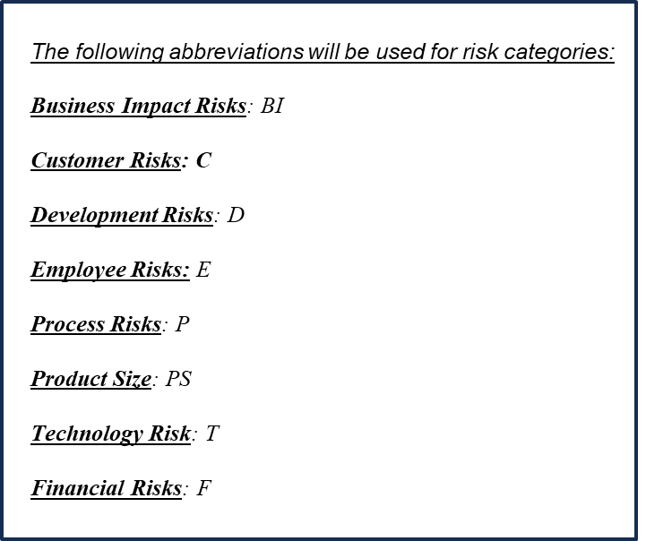

Slide 36

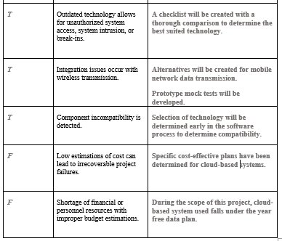
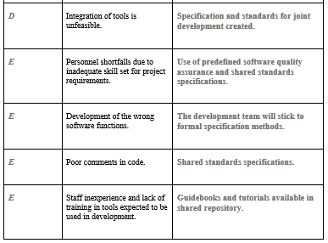

Slide 37
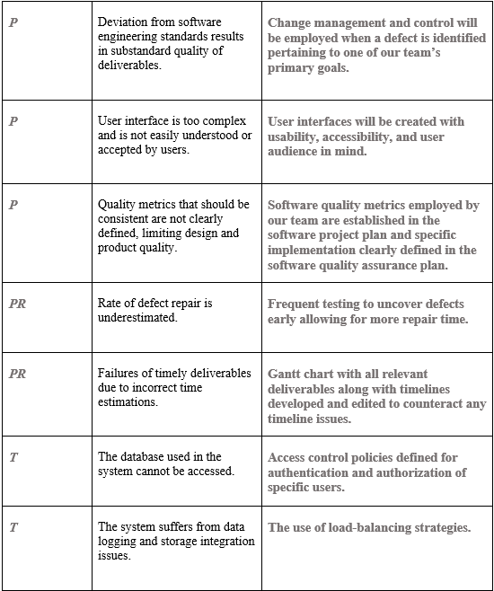

Slide 38
7.0 Appendix

Slide 39
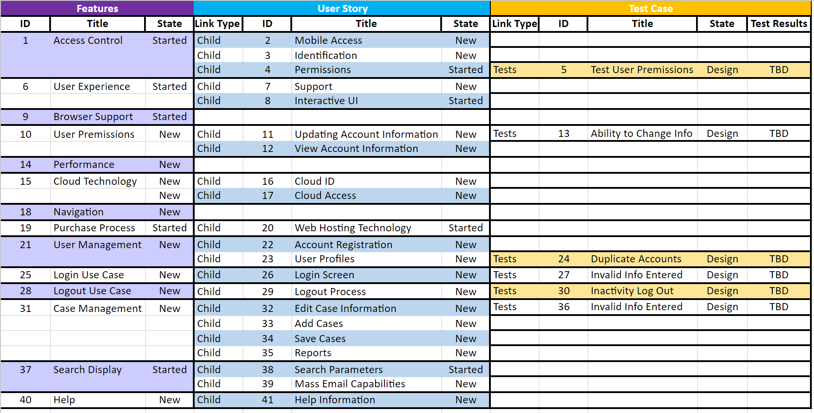
7.1 Traceability Matrix

Slide 40
7.2 References
R. S. Pressman, “Document Templates: Software Project Plan,” R.S. Pressman & Associates, Inc.. [Online]. Available: http://www.rspa.com/docs/Projectplan.html. [Accessed: 14-June-2023].
“Risk Mitigation, Monitoring, and Management Plan,” McGraw Hill Higher Education. [Online]. Available: www.mhhe.com/engcs/compsci/pressman/graphics/Pressman5sepa/common/cs1/rmmm.pdf. [Accessed: 14-June-2023].
R. S. Pressman, “Document Templates: RMMM Plan,” R.S. Pressman & Associates, Inc.. [Online]. Available: http://www.rspa.com/docs/riskmmm.html.[Accessed: 14-June-2023].
“Software Project Plan,” McGraw Hill Higher Education. [Online]. Available: http://www.mhhe.com/engcs/compsci/pressman/graphics/Pressman5sepa/common/cs1/projplan.pdf.[Accessed: 14-June-2023].
“Software Project Plan,” McGraw Hill Higher Education. [Online]. Available: https://www.mhhe.com/engcs/compsci/pressman/graphics/Pressman5sepa/common/cs2/projplan.pdf.[Accessed: 14-June-2023].
“Occupational Employment and Wages, May 2022: Software Developers”, U.S. Bureau of Labor Statistics. [Online]. Available: https://www.bls.gov/oes/current/oes151252.htm#st. [Accessed: 14-June-2023].
Pressman, Roger S., and Bruce R. Maxim. Software Engineering: A Practitioner's Approach . Vol. 9, McGraw-Hill Education , 2020.
Tinytool

